Slide 1
SKILLROVE / REVIEWED SOURCE
Your workflow. A launch worth watching.
A practice launch story using an actual Skillrove homepage screenshot, supplied review notes and a clear delivery boundary.
SHAPE / INTENTION
Agent Workflow Film
01 / 06
Notes:
A practice launch story using an actual Skillrove homepage screenshot, supplied review notes and a clear delivery boundary.

Slide 2
SKILLROVE / REVIEWED SOURCE
One brief. A visible path.
/agent-workflow-film turn my reviewed product brief into a launch story
01
02
INPUT
BOUNDARY
Skillrove / Small skills. Big possibilities.
Display command only. No shell command is executed.
Agent Workflow Film
02 / 06
Notes:
/agent-workflow-film turn my reviewed product brief into a launch story

Slide 3
SKILLROVE / REVIEWED SOURCE
Make the work inspectable.
3 tasks · 45 planned minutes. Estimates are not measured execution time.
01
02
03
Shape the story
Build the draft
Package the next step
Depends on: none
Depends on: outline
Depends on: draft
Agent Workflow Film
03 / 06
Notes:
3 tasks · 45 planned minutes. Estimates are not measured execution time.

Slide 4
SKILLROVE / REVIEWED SOURCE
Keep the result beside the task.
The status reflects your supplied review, not an agent benchmark.
01
02
03
Shape the story
Build the draft
Package the next step
A three-part launch outline.
The actual Skillrove homepage captured for this practice film.
A proposed delivery checklist.
Agent Workflow Film
04 / 06
Notes:
The status reflects your supplied review, not an agent benchmark.

Slide 5
SKILLROVE / REVIEWED SOURCE
Show the proof boundary.
2 / 3 tasks reviewed. Incomplete work stays visible.
01
02
03
REVIEWED
REVIEWED
PLANNED
Every headline maps to a reviewed requirement.
Product facts and labels match the supplied brief.
A human reviews the final exported files before launch.
Agent Workflow Film
05 / 06
Notes:
2 / 3 tasks reviewed. Incomplete work stays visible.

Slide 6
SKILLROVE / REVIEWED SOURCE
Skillrove / Small skills. Big possibilities.
Bring your product. Keep the result in view.
01
02
SOURCE
DELIVERY
2 reviewed/reference records
Editable brief, captions, timeline and real local MP4 exports.
Agent Workflow Film
06 / 06
Notes:
Bring your product. Keep the result in view.

Slide 7
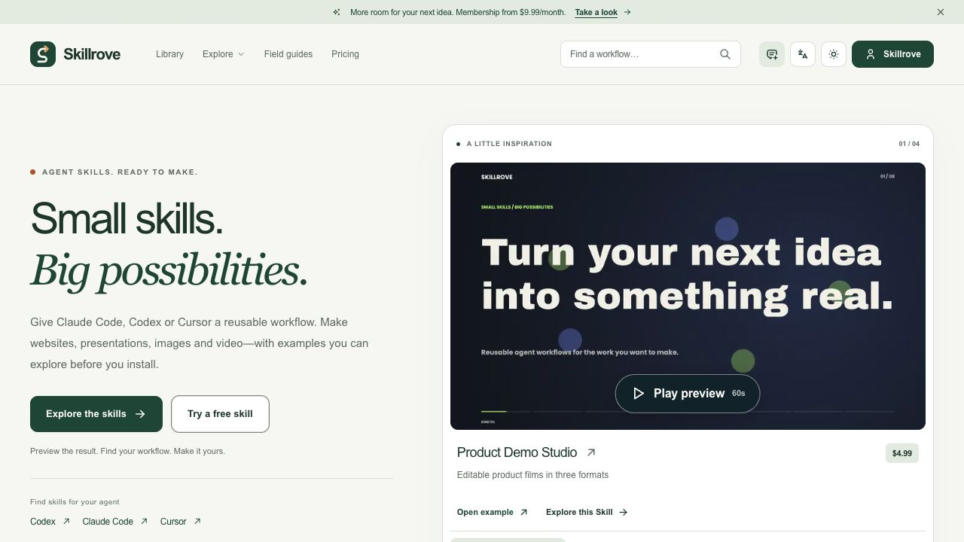
Skillrove / supplied result screenshot
Notes:
Actual user-supplied result screenshot. Rights confirmation is a declaration, not an independent license verification. Never claim this is a recorded agent run.

